Slide 1

AVATAR Movie review
PRESENTATION BY
PRAMISHA SHRESTHA

Slide 2
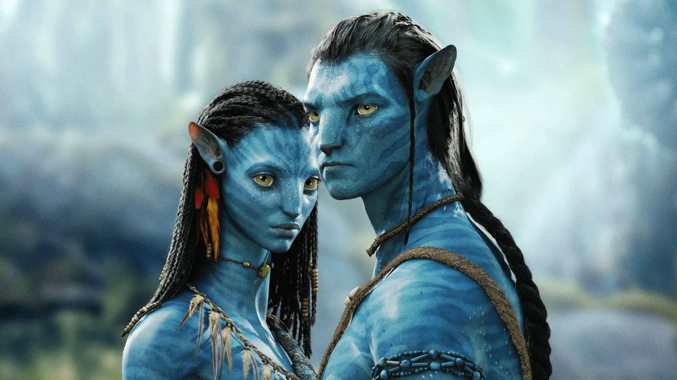
ABOUT MOVIE
James Cameron's Academy Award –winning 2009 epic adventure “Avatar”, returns to theaters September 23 in stunning 4k High Dynamic Range. On the lush alien world of Pandora live the Na’vi, begins who appear primitive but are highly evolved. Because the planet’s environment is poisonous, human/Na’vi hybrids, called Avatars, must link to human minds to allow for free movement on Pandora. Jake Sully (Sam Worthington), a paralyzed former Marine, becomes mobile again through one such Avatar and falls in love with Na’vi woman (Zoe Saldana). As a bond with her grows, he is drawn into a battle for the survival of her world.

Slide 3


MOVIE INFO
Rating: PG 13 (Language/Warfare/Intense Battle Sensuality/Sensuality/Some Smoking)
Genre: Sci-fi, Adventure, Action, Fantasy
Languages: English, Na’vi language, Korean, German
Director: James Cameron
Producer: James Cameron, Jon landau
Writer: James Cameron
Release Date (Theaters): Dec 18, 2009
Rerelease Date (Streaming): Feb 10, 2016
Box Office (Gross USA): $2.923 billion USD
Runtime: 2h 35m
Distributor: 20th Century fox
Production Co: Dune, Lightstrom Entertainment, Ingenious Film Partners
Sound mix: DTS, Dolby Digital, SDDS, Dolby

Slide 4










MOVIE CAST & CREW
Sam Worthington
As
Jake Sully
Zoe Saldana
As
Neytiri Voice
Sigourney Weaver
As
Grace Augustine
Stephen Lang
As
Col. Miles Quaritch
Giovanni Ribisi
As
Parker Selfidge
Michelle Rodriguez
As
Trudy Chacone
Joel David Moore
As
Norm Spellman
James Cameron
As
Director

Slide 5

VISUAL MARVEL
The most striking asspects of Avatar is undeniably its revolutionary visual efects.Camerons use of 3D technology and motion capture brings Pandora to life with breathtaking realism. The lush landscapes, exotic ffloraa, and unique fauna create a visually stunning and immersive experience. The flims attention todetail in crafting the Na‘vi people and their culture addss layer of authenticity to the fictional world.

Slide 6
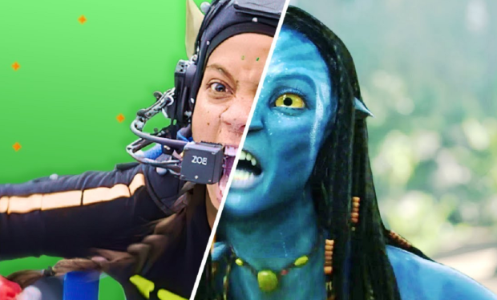
INNOVATIVE TECHNOLOGY
Avatar is a trailblazer in terms of technology and filmmaking techniques. The use of motion capture not only enhance the realism of the characters but also allows for a seamless integration of live-actin and computer-generated elements. The films success in pushing the boundaries of what is possible with visual effects has had a lasting impact on the film industry.

Slide 7
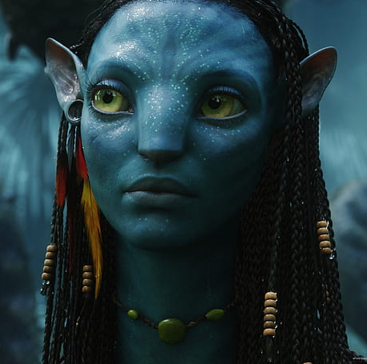
ENGAGING STORYLINE
While some critics argue that the plot is somewhat predictable and reminiscent of other fish out of water or white savior narratives, the films narrative serves as solid foundation for the visual spectacle. The story follows Jake Sully, a paraplegic Marine, as he becomes immersed in the conflict between the human military industrial complex and the indigenous Na’vi population.

Slide 8
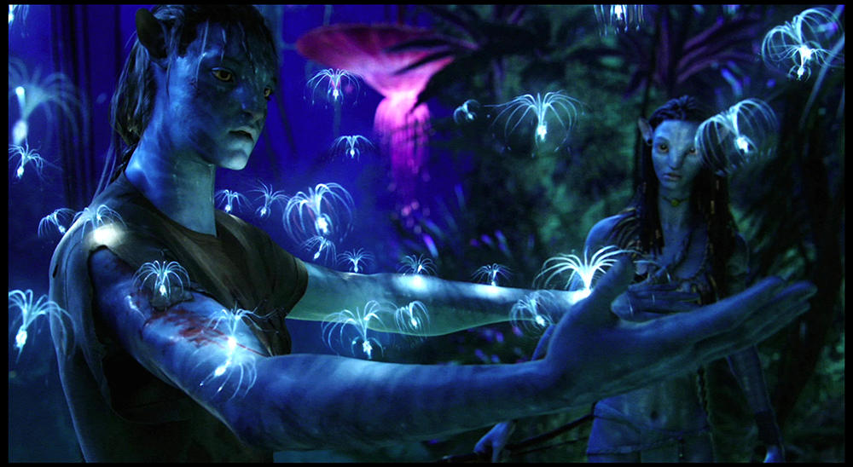
ENVIRONMENTAL AND SOCIETAL THEMES:
Avatar explores relevant and thought-provoking themes, including environmentalism, corporate greed, and the clash between indigenous cultures and industrialized societies. Thee films social and political undertones add depth to the narrative and elevate it beyond a simple science fiction adventure.

Slide 9

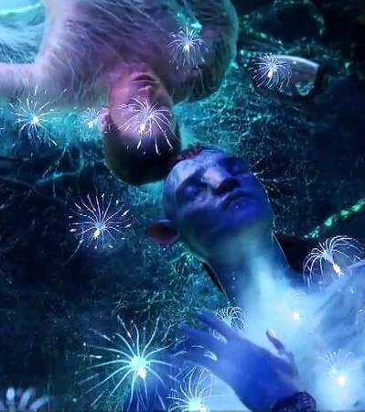
CINEMATIC EXPERIENCE
Beyond its technological achievements, Avatar is a testament to Cameron's directorial prowess. The films pacing, action sequences, and use of 3D contribute to an unparalleled cinematic experiences. The aerial scenes and epic battles are particularly memorable, showcasing Cameron's ability to deliver high-octane thrills.

Slide 10

BOX OFFICE SUCCESS
Avatar became the highest-grossing film of all time, surpassing Cameron's own Titanic. Its immense commercial success reflects its broad appeal and popularity among audiences worldwide.
In conclusion, Avatar is not just a movie it’s a cinematic milestone. While some may critique certain narrative elements, solidifies its place in film history. James Cameron's Avatar remains a must watch for its groundbreaking technology and the sheer spectacle of its otherworldly adventure.

Slide 11
THE END

